Slide 1

Git versioning: Keep track of your changes
Physalia course 2022
Instructor: Jacques Serizay
Notes:
Hello everybody and thank you for attending my presentation. I am going to talk about the project I recently started working on in the Spassky and Koszul labs, both located in Paris. This project focuses on the unusual cooption of the mitotic machinery to drive, not cell division but cell differentiation.

Slide 2
Keeping track of changes with git
https://happygitwithr.com/
Git is a version control system.
Git manages the evolution of a set of files – called a repository – in a sane, highly structured way.
Its original purpose was to help groups of developers work collaboratively on big software projects.
Essentially, this is “Track Changes” features from Microsoft Word on steroids.

Slide 3

Keeping track of changes with git
Ever time-stamped a file? Git does the same, for one or several files, and allows you to revert back to previous files or compare changes (for text files).

Slide 4
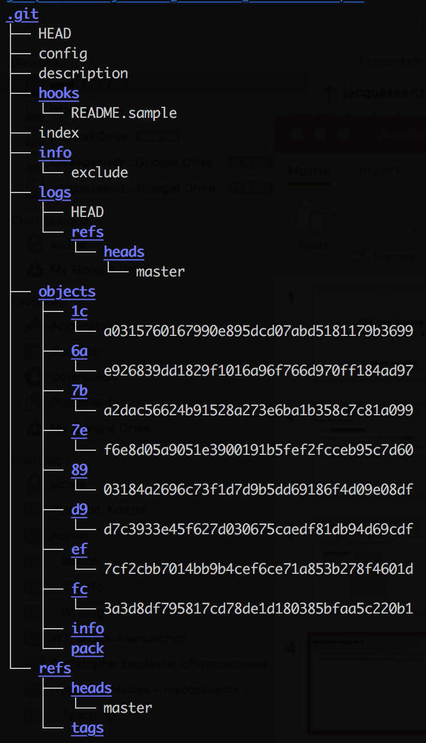
Keeping track of changes with git
Your working directory only contains the 2 files (pdf and gdoc) you are working on, and changes of these files are stored in the `.git` subfolder, in a compressed way.

Slide 5
Keeping track of changes with git
Git’s main downside is… git is not user-friendly!
It’s painful to visualize changes, to browse history, to compare files, …
No native graphical interface

Slide 6
Git vs github
Git is a software, locally installed on one’s computer
$> git --help
“Track Changes” features

Slide 7
Git vs github
Git is a software, locally installed on one’s computer
Github is an Internet hosting service, storing your local `git` repository (files AND changes) on-line (“remotely”):
$> git
“Track Changes” features
https://github.com/
Dropbox features

Slide 8
Git vs github
You are working on your manuscript draft in Word: you may rewrite sentences, resolve previous comments, reply to others still open, … As long as you are working on your own, this works.
Now you want to share it with others → you decide to put the document online as a Google Doc, allow access to others, and enable synchronization with your local Google Drive.
Your colleagues will eventually rewrite/resolve/reply together with you (sometimes with conflicting changes!), and everyone will see who is doing what, etc.
The Google Doc is your “remote repository” and your local Google Drive folder is your “local repository”
Typically, both are continuously synced, whereas Git and Github are not sync-ed “live”, you do it manually and whenever you want.

Slide 9
Git vs github
Github, gitlab, bitbucket: all different internet hosting services doing the same thing:
Storing your local git repositories online, to make available to others.
Allow specific online-based features: issues and pull requests
Easy ”time-travel” (i.e. browsing files back in time) with permanent links
Search function!

Slide 10
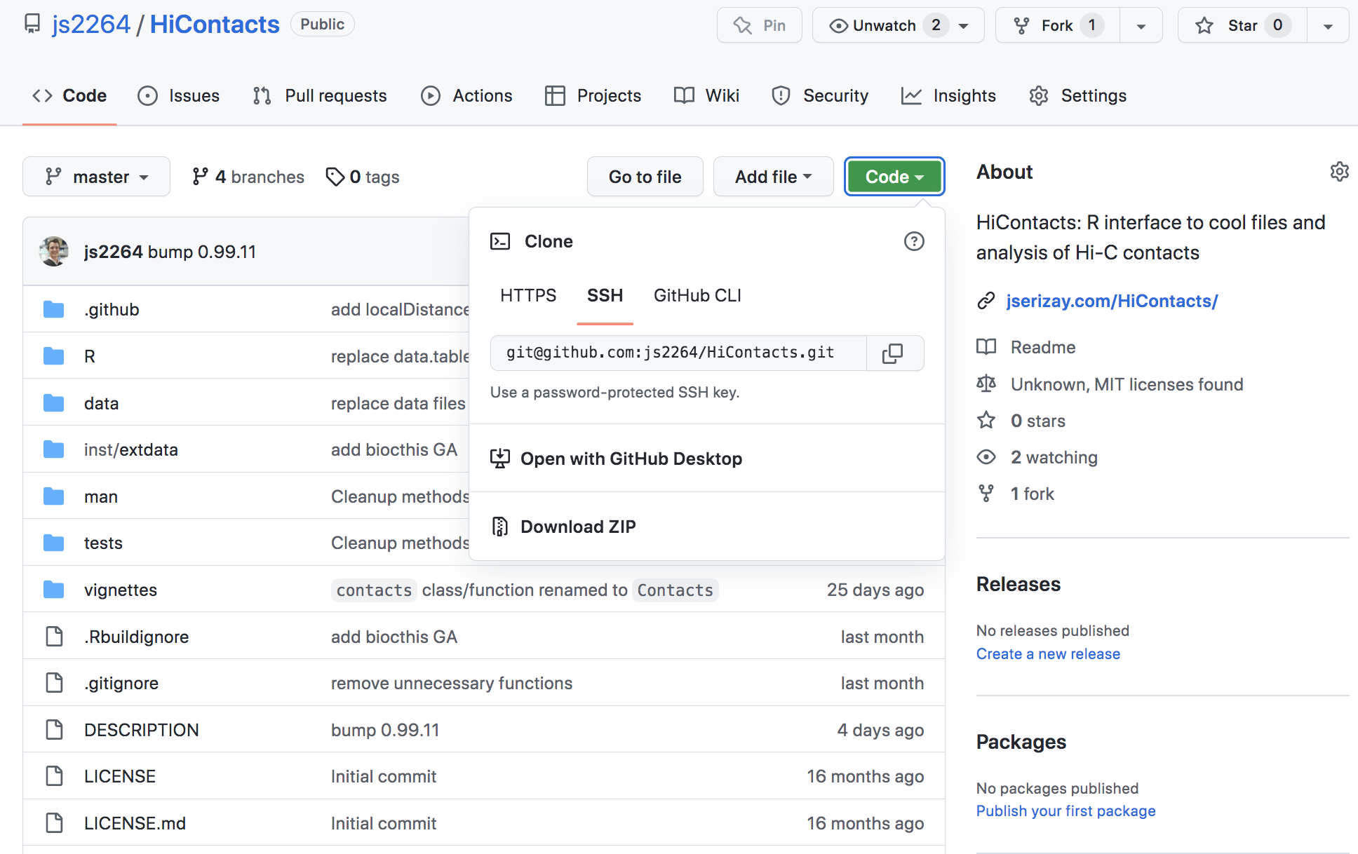
Git vs github
Github, gitlab, bitbucket: all different internet hosting services doing the same thing:
Storing your local git repositories online, to make available to others.

Slide 11
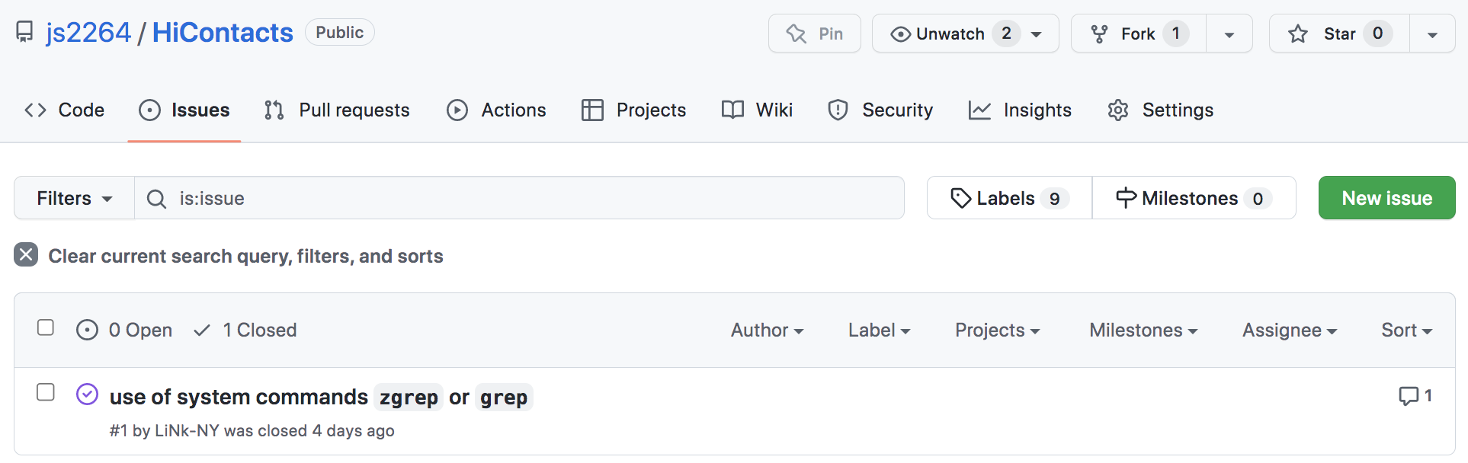
Git vs github
Github, gitlab, bitbucket: all different internet hosting services doing the same thing:
Allow specific online-based features: issues and pull requests

Slide 12
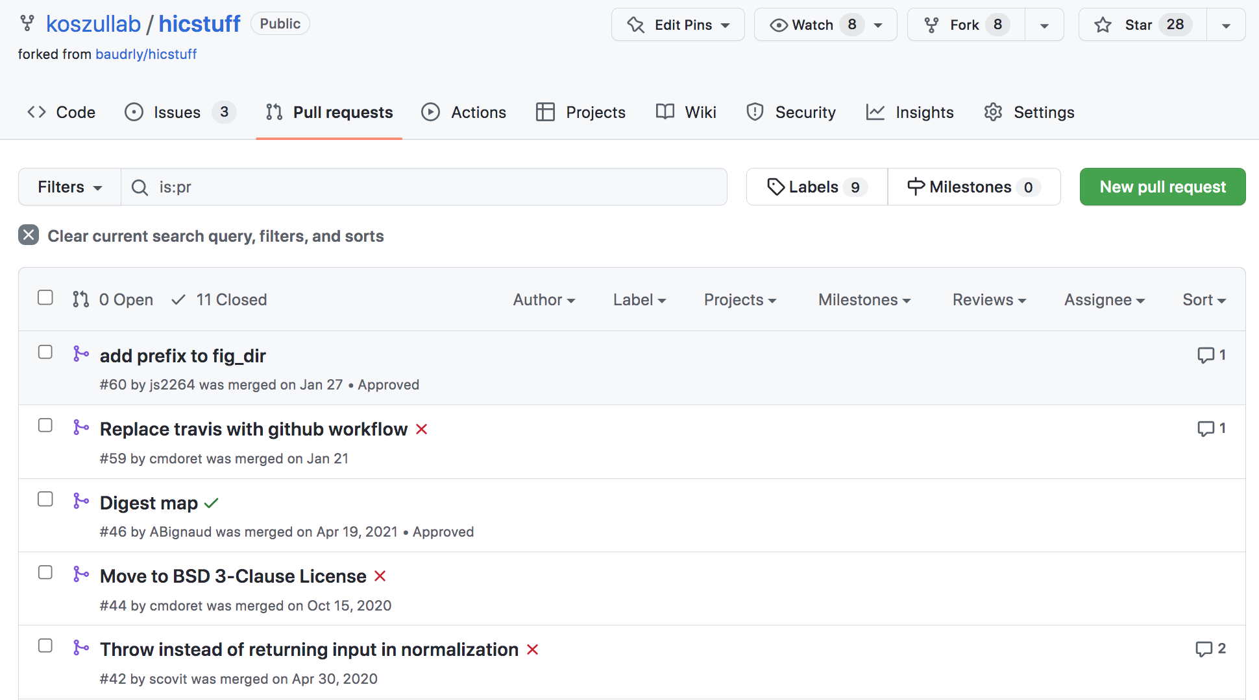
Git vs github
Github, gitlab, bitbucket: all different internet hosting services doing the same thing:
Allow specific online-based features: issues and pull requests

Slide 13
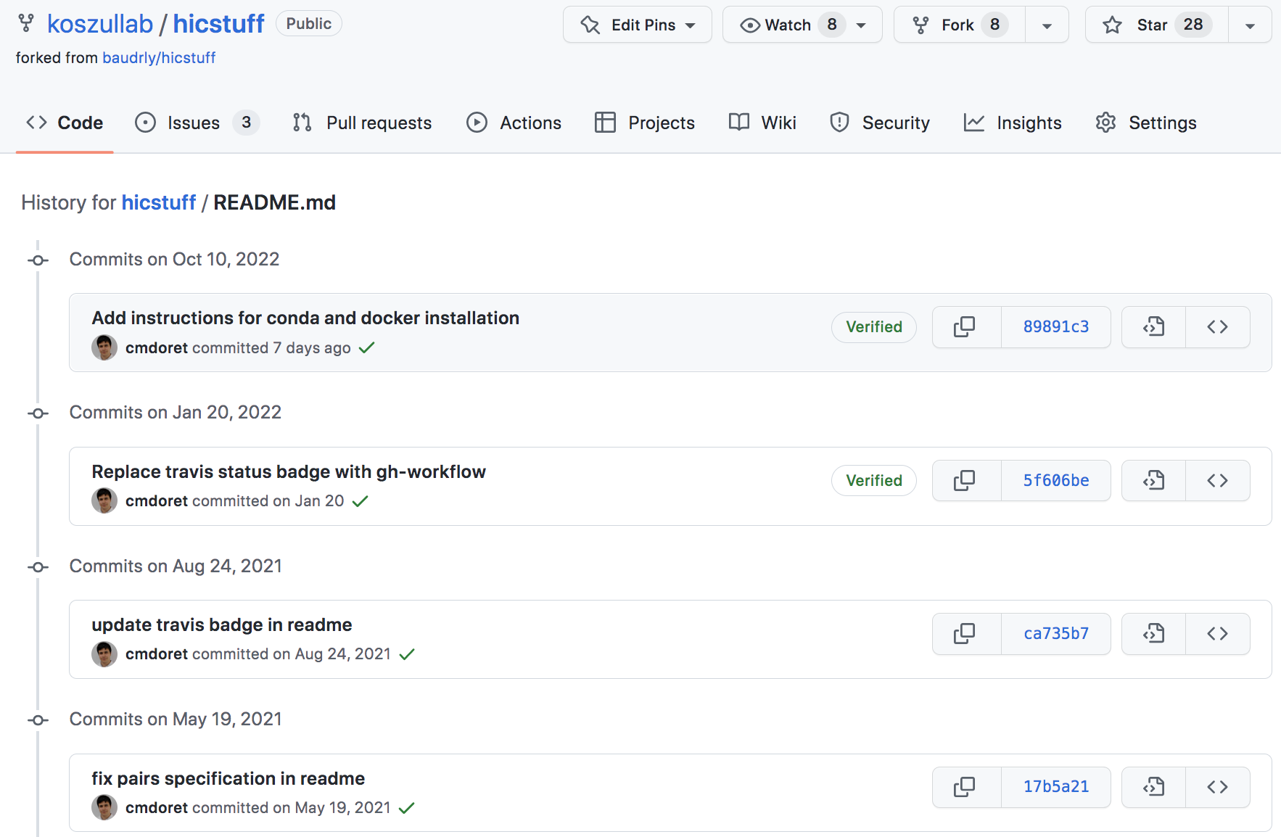
Git vs github
Github, gitlab, bitbucket: all different internet hosting services doing the same thing:
Easy ”time-travel” (i.e. browsing files back in time) with permanent links

Slide 14
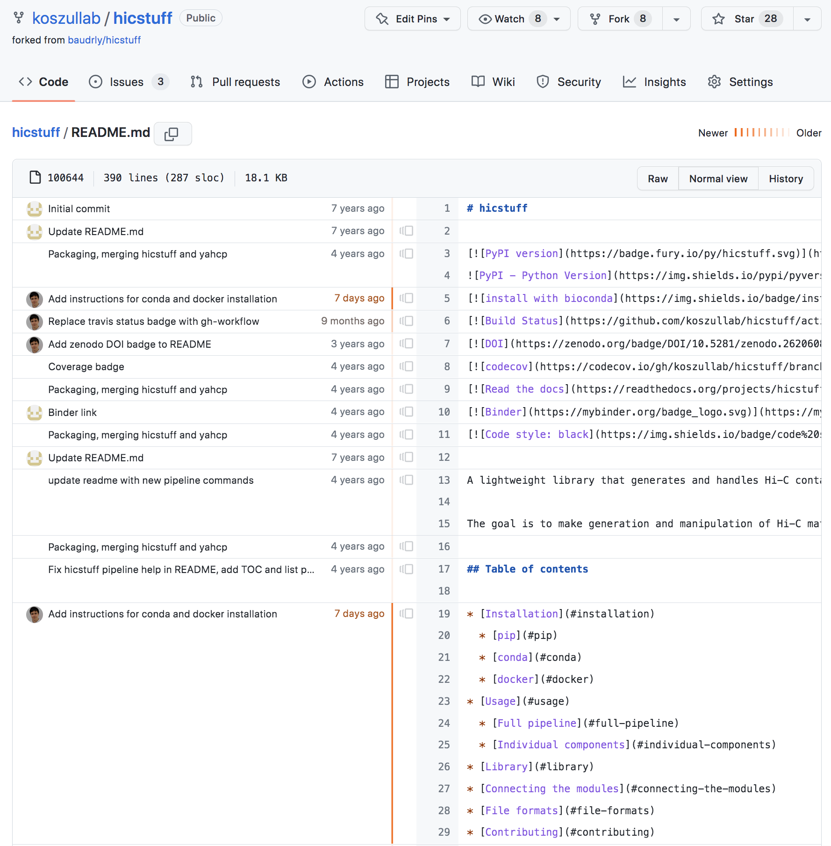
Git vs github
Github, gitlab, bitbucket: all different internet hosting services doing the same thing:
Easy ”time-travel” (i.e. browsing files back in time) with permanent links

Slide 15
Github and organizations
A public repository is readable by the world. The owner can grant higher levels of permission to others, such as the ability to push commits.
A private repository is invisible to the world. The owner can grant read, write (push), or admin access to others.
There is also a notion of an organization, which can be useful for managing repository permissions for entire teams of people.

Slide 16
Github and organizations
A public repository is readable by the world. The owner can grant higher levels of permission to others, such as the ability to push commits.
A private repository is invisible to the world. The owner can grant read, write (push), or admin access to others.
There is also a notion of an organization, which can be useful for managing repository permissions for entire teams of people.
→ Git has been re-purposed by the data science community.
We now also use it, IN COLLABORATION WITH A CLOUD-BASED GIT HOST, to manage the diverse collection of files that make up typical data analytical projects, which often consist of data, figures, reports, and, yes, source code.

Slide 17
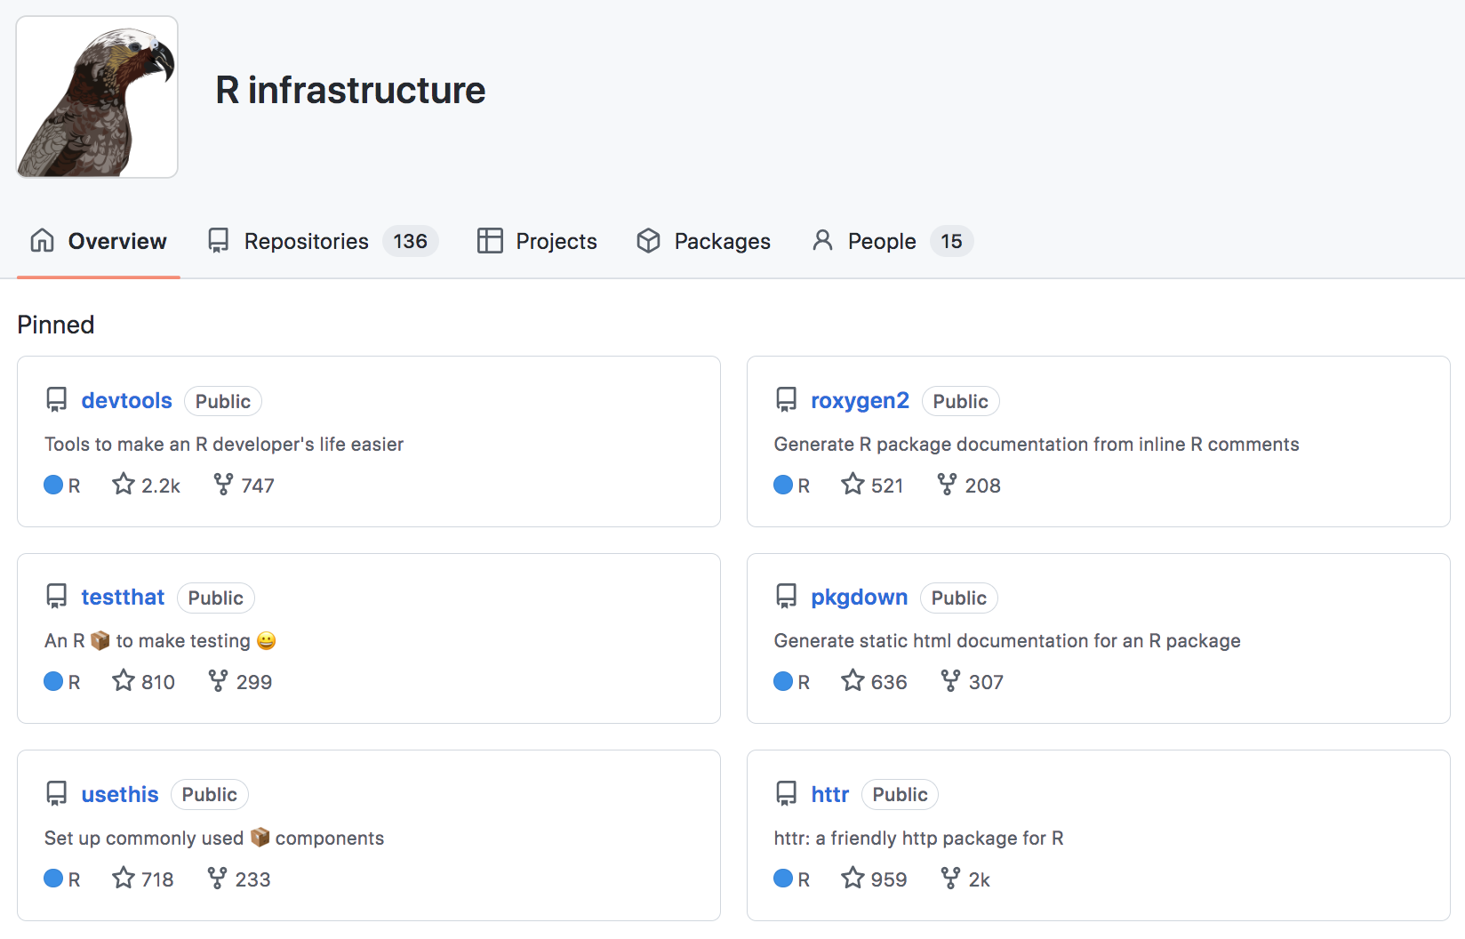
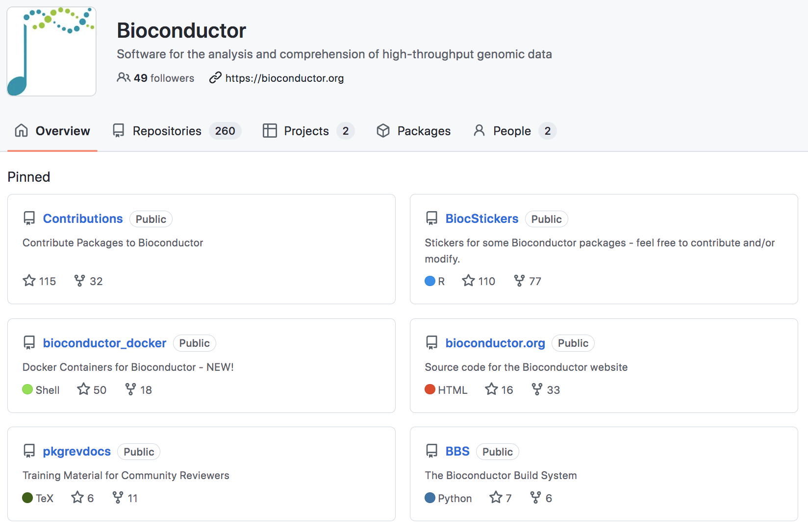
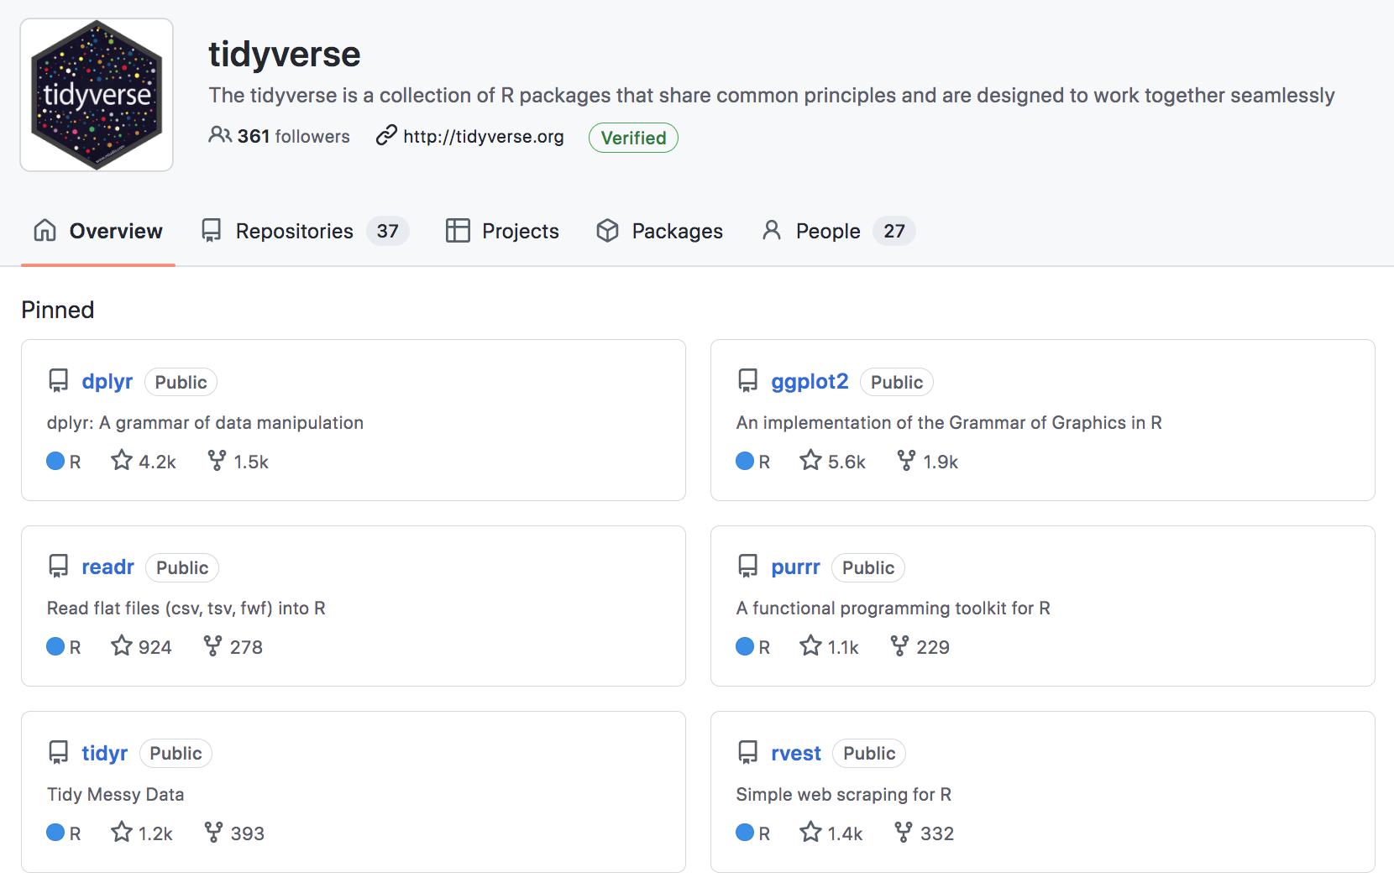
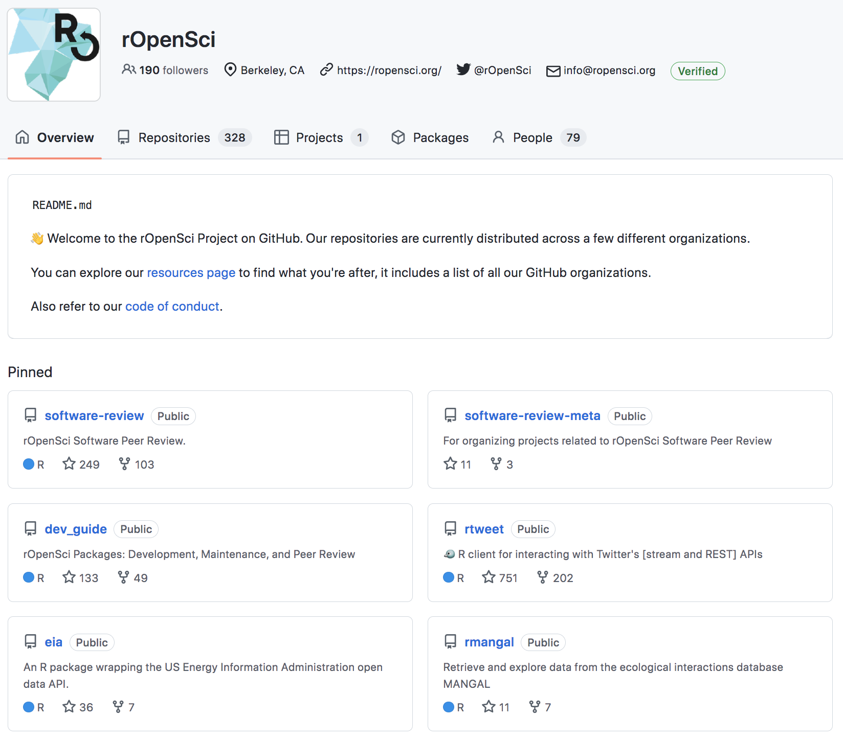
Github and organizations

Slide 18
How to set things up
Register for a GitHub account
MAKE SURE YOU ARE RUNNING R/RStudio/BiocManager WITH THE APPROPRIATE VERSION!
Install Git: https://git-scm.com/downloads, or:
Linux: `sudo apt-get install git`
Mac: `xcode-select –install` (needs Xcode)
Windows: `choco install git.install` (needs Chocolatey)

Slide 19
How to set things up
Register for a GitHub account
MAKE SURE YOU ARE RUNNING R/RStudio/BiocManager WITH THE APPROPRIATE VERSION!
Install Git: https://git-scm.com/downloads, or:
Linux: `sudo apt-get install git`
Mac: `xcode-select –install` (needs Xcode)
Windows: `choco install git.install` (needs Chocolatey)
Configure git from R (easy)
usethis::git_sitrep()
gert::git_config_global_set("user.name", "Jacques")
gert ::git_config_global_set("user.email", "jacquesserizay@gmail.com")
usethis ::git_vaccinate()
usethis ::use_git()
usethis ::use_git_ignore("*.Rproj")
# Don’t forget to make an initial commit!

Slide 20
How to set things up
Configure github (harder):
Git can communicate with a remote server using one of two protocols, HTTPS or SSH, and the different protocols use different credentials.
We must use SSH, as this means of communications is required later on, for Bioconductor submission.
For that, we need to generate a pair of private/public SSH keys, connect to GitHub from R and push the public key to GitHub.

Slide 21
How to set things up
Configure github (harder):
Git can communicate with a remote server using one of two protocols, HTTPS or SSH, and the different protocols use different credentials.
We must use SSH, as this means of communications is required later on, for Bioconductor submission.
For that, we need to generate a pair of private/public SSH keys, connect to GitHub from R and push the public key to GitHub.
gh::gh_whoami()
usethis::gh_token_help()
#Create a GH PAT
usethis ::create_github_token()
gitcreds ::gitcreds_set()
#Paste your GitHub token, not your password!
#Add an SSH key to GitHub
usethis ::use_github() credentials::ssh_setup_github()

Slide 22
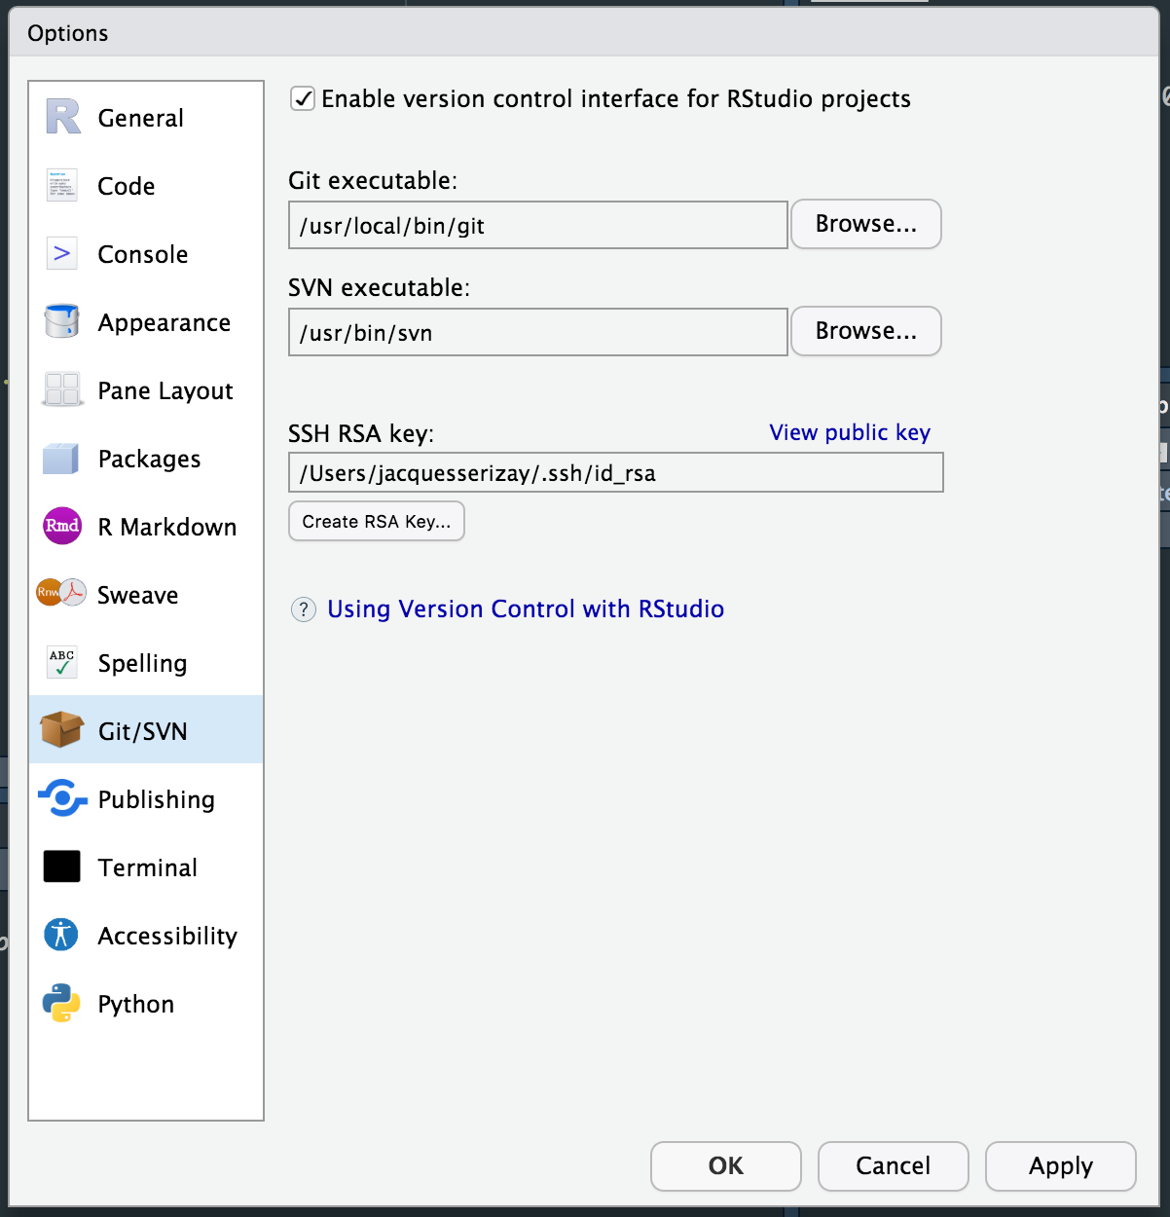
How to set things up
Configure github (harder):
Fallback approach: create a key in RStudio

Slide 23
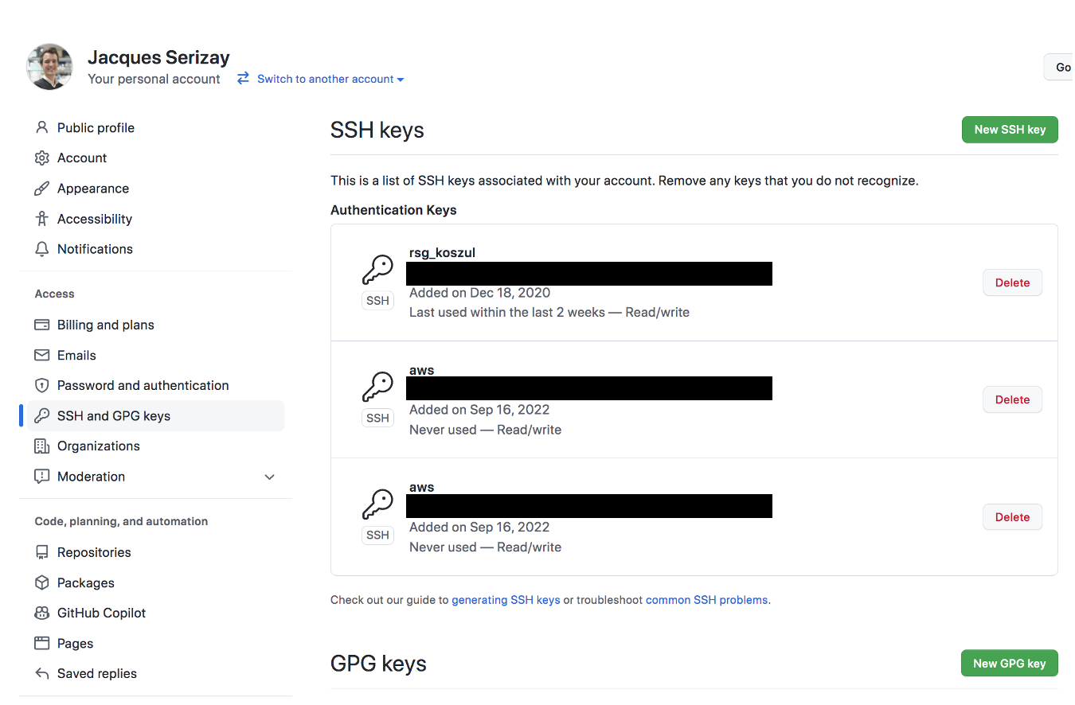
How to set things up
Configure github (harder):
Then, we need to upload the public key to GitHub
1
3
2

Slide 24
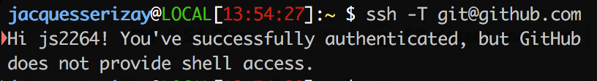
How to set things up
Configure github (harder):
Test it with `ssh -T git@github.com`

Slide 25
How to set things up
If you are still struggling…
https://happygitwithr.com/usage-intro.html#usage-intro

Slide 26
Lather-rinse-repeat
Write functions
Document functions
Arguments
Imports
examples
> devtools::document()
> devtools::run_examples()
> devtools::test()
> devtools::load_all()
Git commit
Github push
Test functions
Add example data
Add vignettes
Publish supporting website
Submit to Bioconductor

Slide 27
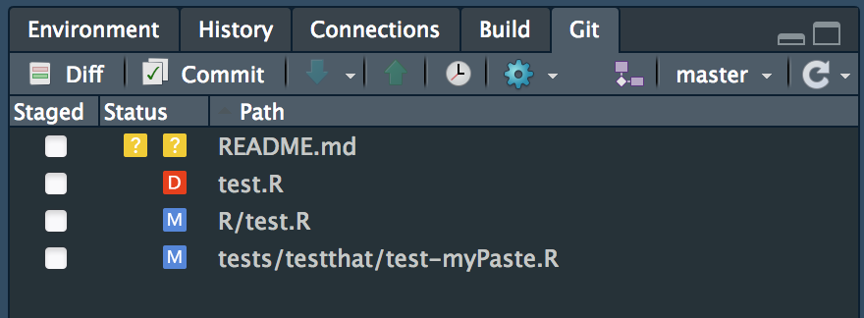
Lather-rinse-repeat

Slide 28
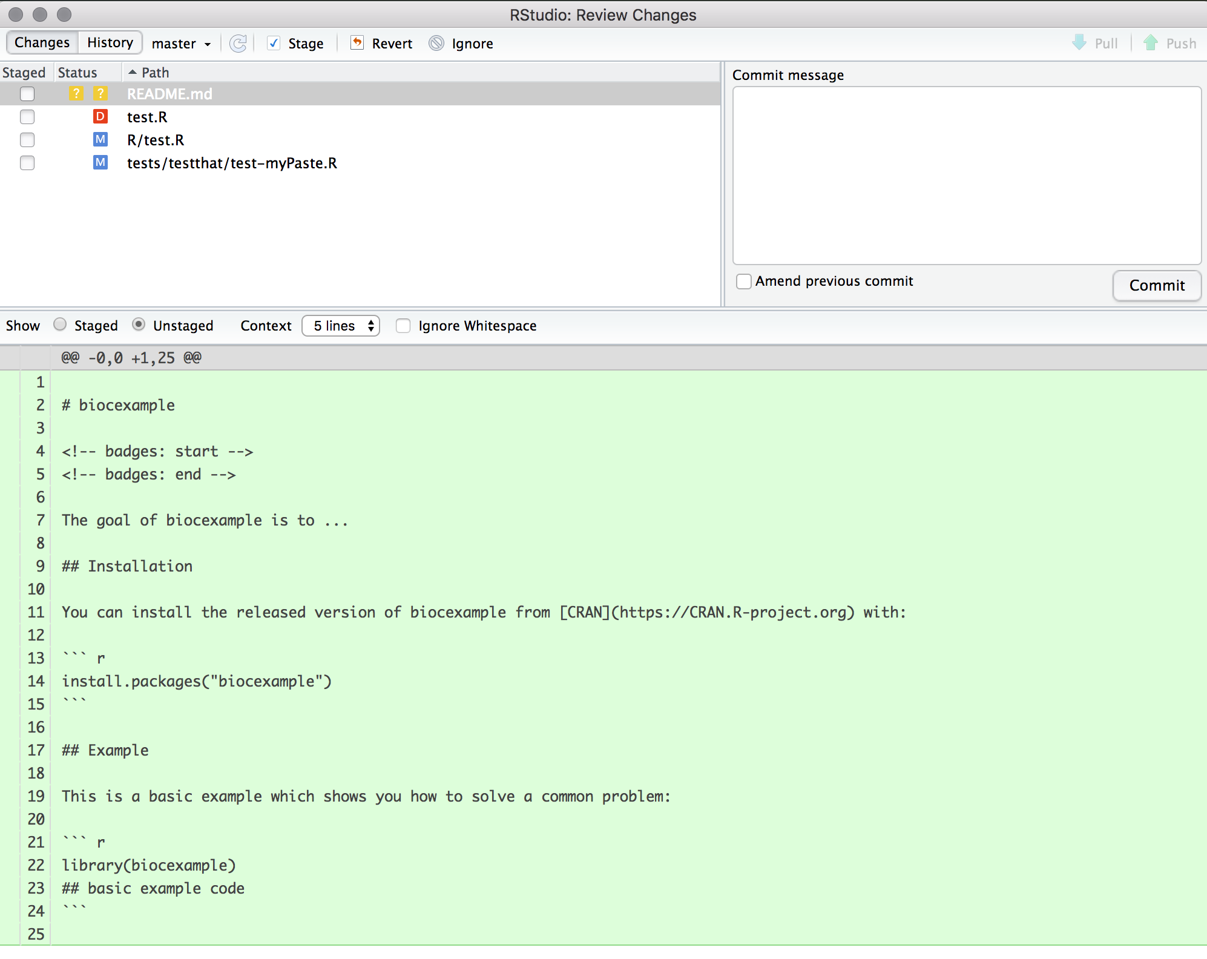
Lather-rinse-repeat

Slide 29
Lather-rinse-repeat

